Slide 1









WORKSHOPS
Scale RAG applications with Pinecone and Canopy
Zero Shot Labs x San Francisco AI User Group
Daryle Serrant
Data Scientist & ML Consultant
byteSolid Solutions

Slide 2


During this workshop you will…
1
Setup a RAG pipeline using Canopy
2
Test RAG pipeline

Slide 3
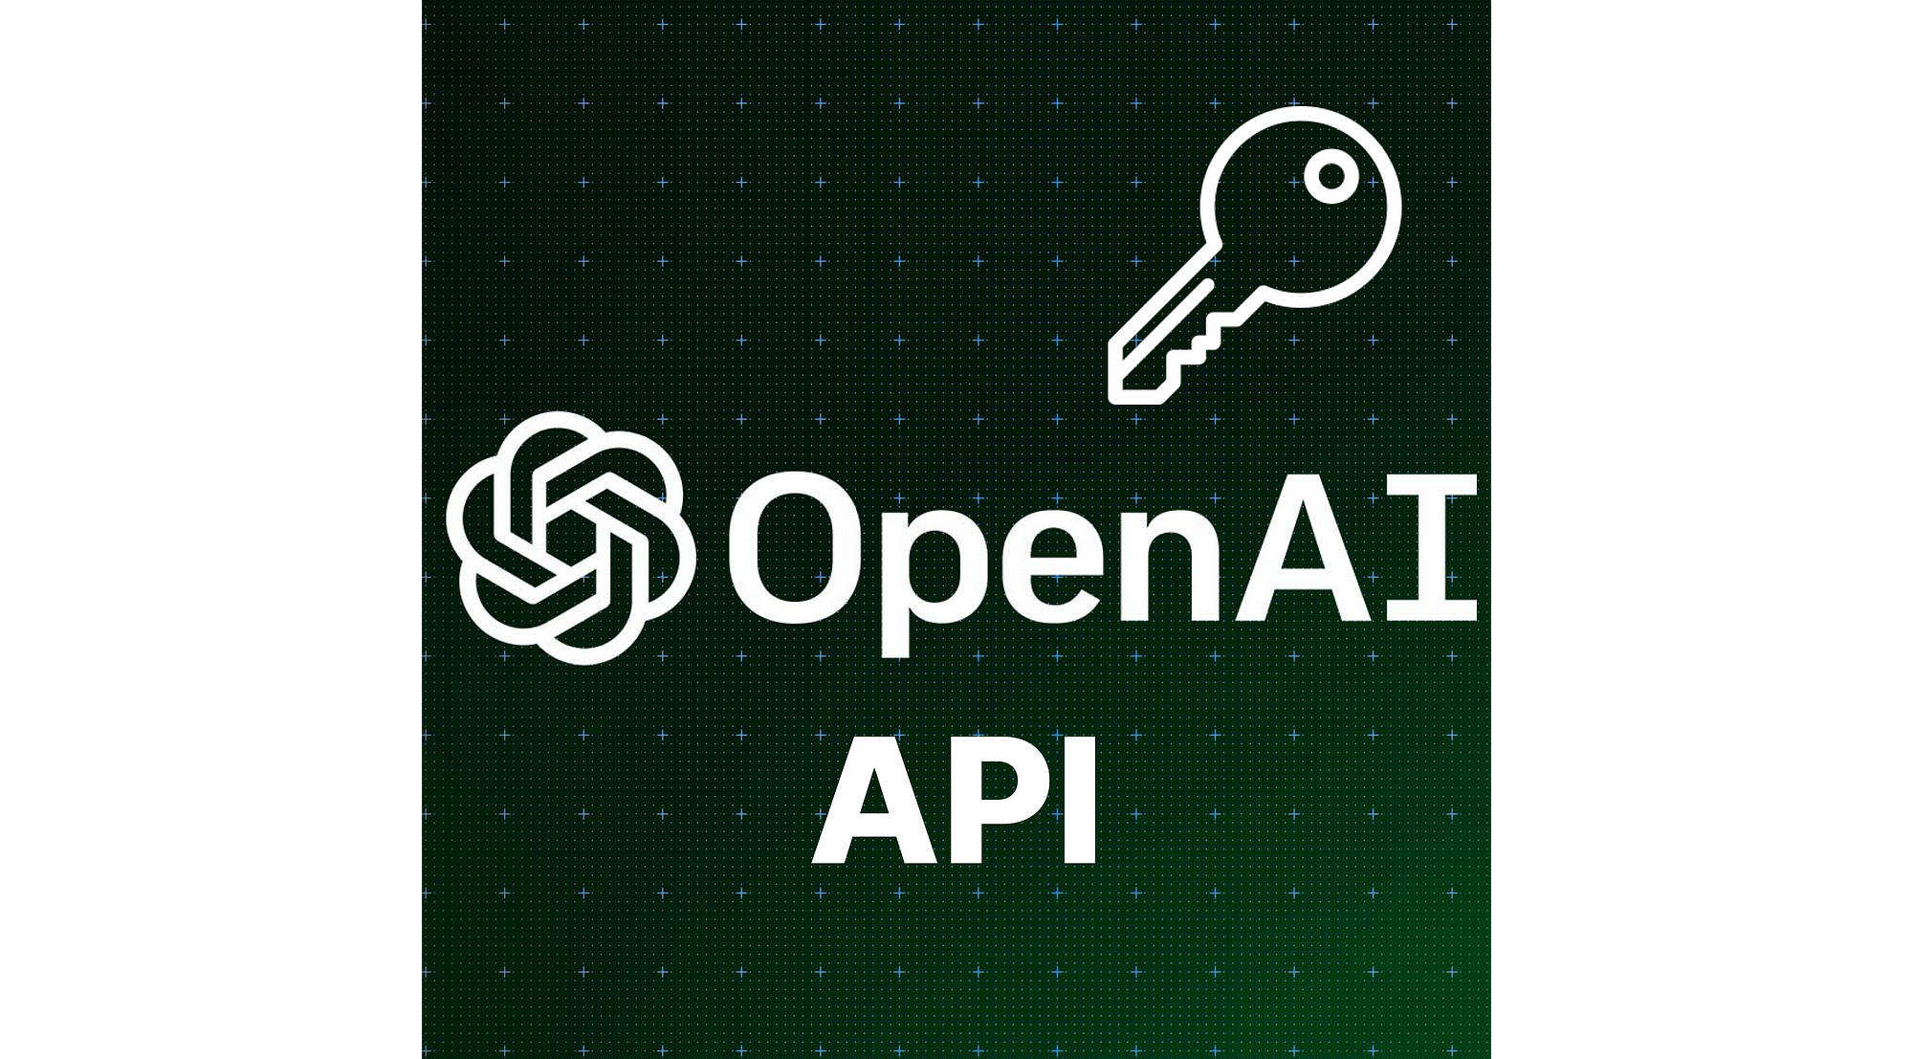


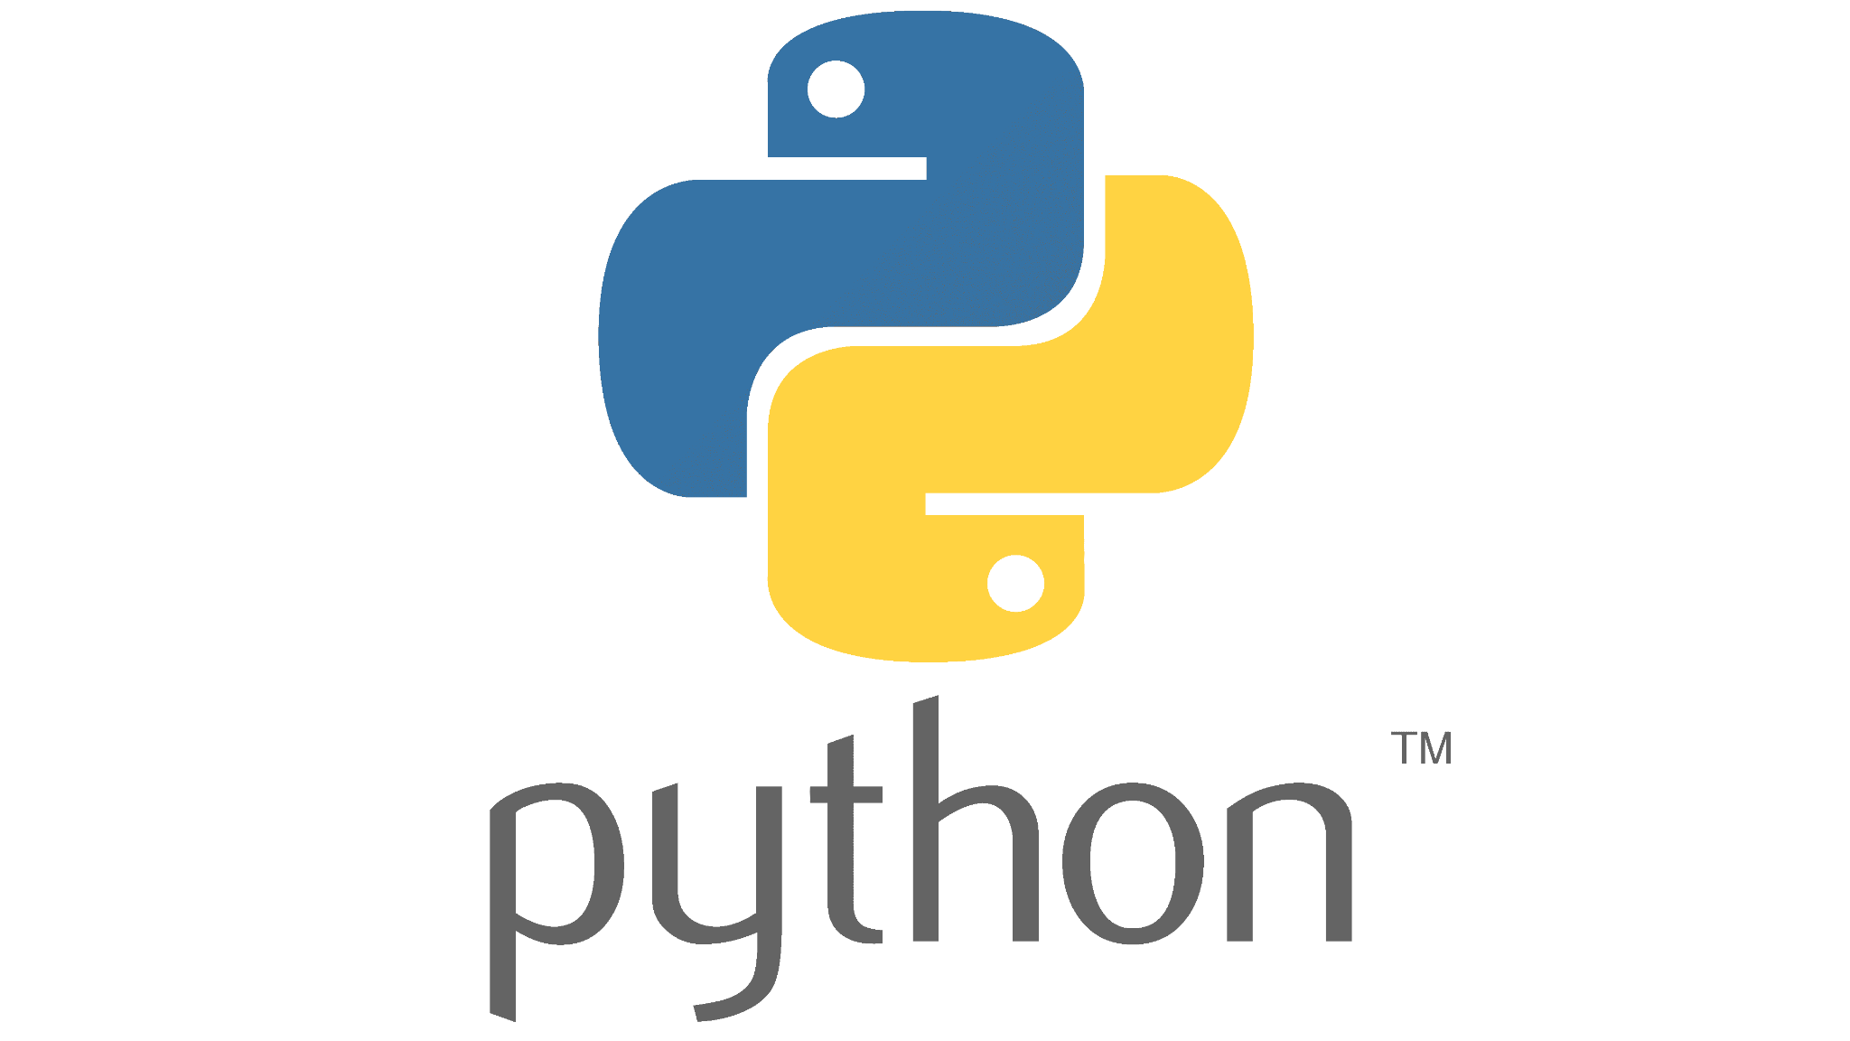
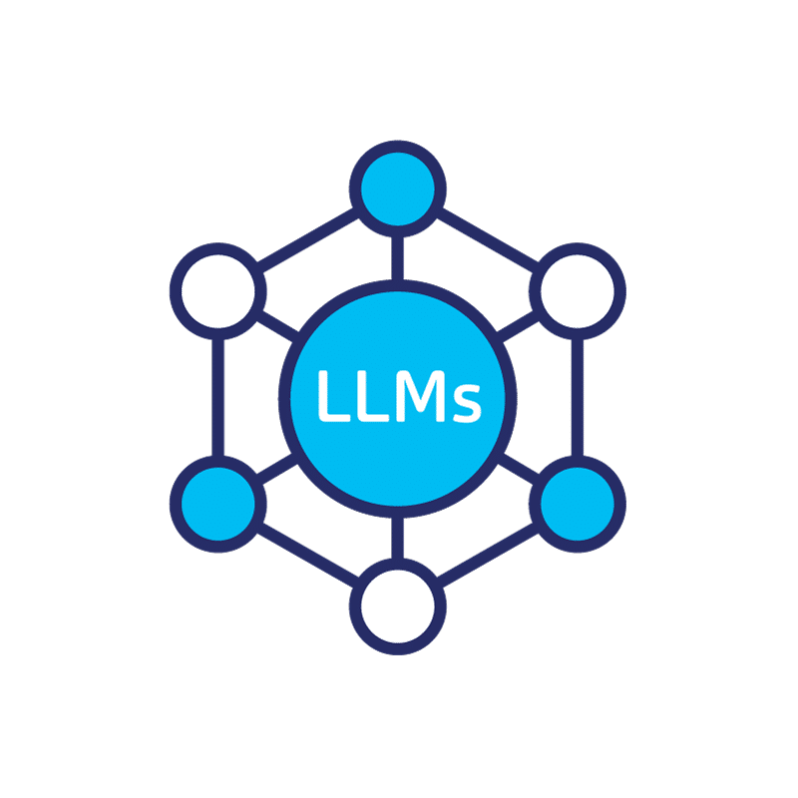
Prerequisites
1
OpenAI API Key
2
Pinecone API Key
3
Basic familiarity with Python and Google Colab
4
Basic familiarity with Prompting / Large Language Models (LLMs)

Slide 4
Table of Contents / Agenda
1
Tech Overview [20 Minutes]
2
Hands-on Practice [20 Minutes]
3
Final Quiz

Slide 5


Tech Overview

Slide 6
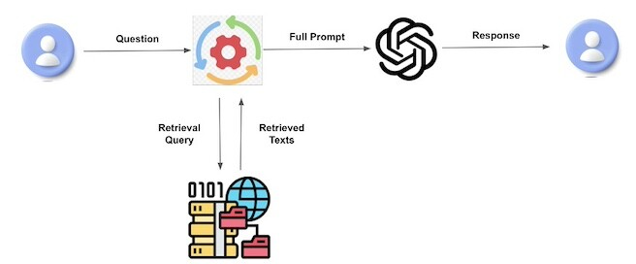
What is Retrieval Augmented Generation (RAG)?

Slide 7
Canopy Framework by Pinecone
Open-source framework for RAG pipelines
Integrates with all OpenAI LLMs (LLaMA coming soon)
Uses Pinecone vector database
Free for up to 100K vectors
Highly scalable production ready paid plans
Supports data formats
Plain text (.txt)
Apache Parquet
JSONL
support for PDF files coming soon
Notes:
Intro to Canopy Framework by Pinecone
Fully open-source framework for building RAG pipelines
Easily integrates with all OpenAI LLMs (LLaMA coming soon)
Uses Pinecone vector database for storing information
Free for up to 100K vectors (around 15M words or 30K pages of text)
Highly scalable production ready through paid plans
Supports data formats
Plain text (.txt)
Apache Parquet
JSONL
support for PDF files coming soon

Slide 8
Features of Canopy
Chunk text data
Vectorize text data
Chat history management
Query optimization
Context retrieval (including prompt engineering)
Augmented generation
Interactive side-by-side RAG/No RAG comparisonn
Notes:
Features of Canopy
Chunking your text data
Vectorizing your text data
Chat history management
Query optimization
Context retrieval (including prompt engineering)
Augmented generation
Interactive side-by-side RAG/No RAG comparison of output response

Slide 9
Additional Features
Generate Visuals and Animations from your Data
Asks Data Questions
Automate Data Cleaning and Prepping
Download your Data into .csv or .xlxs Formats
Create Statistical Models

Slide 10
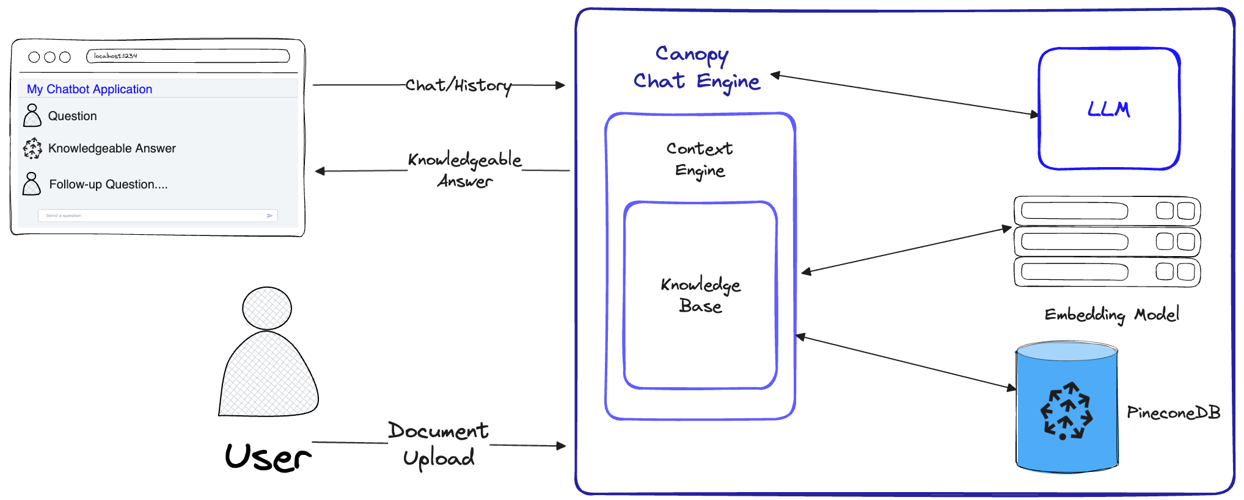
Canopy Core Library
Canopy Core Library (03 Classes)

Slide 11
KnowledgeBase Class
Manages data for RAG workflow
Chunks and transforms text data into text embeddings
Stores embeddings in Pinecone vector database
Retrieve relevant document chunks from database.
Notes:
KnowledgeBase Class
Manages your data for the RAG workflow.
Automatically chunks and transforms your text data into text embeddings
Stores embeddings in a Pinecone vector database
Given a text query - the KnowledgeBase will retrieve the most relevant document chunks from the database.

Slide 12
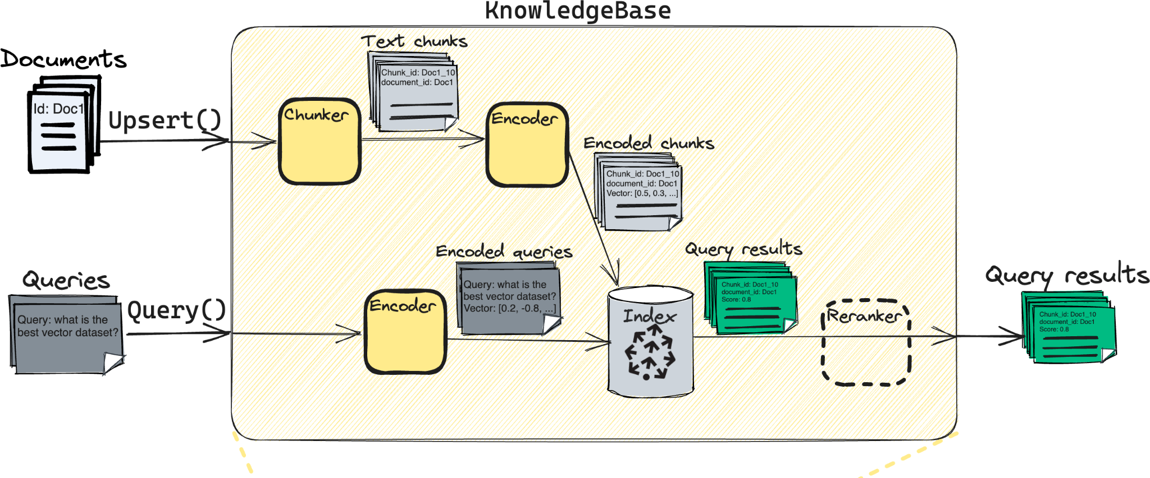
KnowledgeBase Class Workflow
https://github.com/pinecone-io/canopy/blob/main/.readme-content/class_architecture.png

Slide 13
ContextEngine Class
Performs the “retrieval” part of RAG
Utilizes KnowledgeBase to retrieve the most relevant documents
Formulates textual context used as a prompt for LLM
Notes:
ContextEngine Class
Performs the “retrieval” part of RAG.
Utilizes the underlying KnowledgeBase class to retrieve the most relevant documents from vector database
Formulates a coherent textual context to be used as a prompt for the LLM.

Slide 14
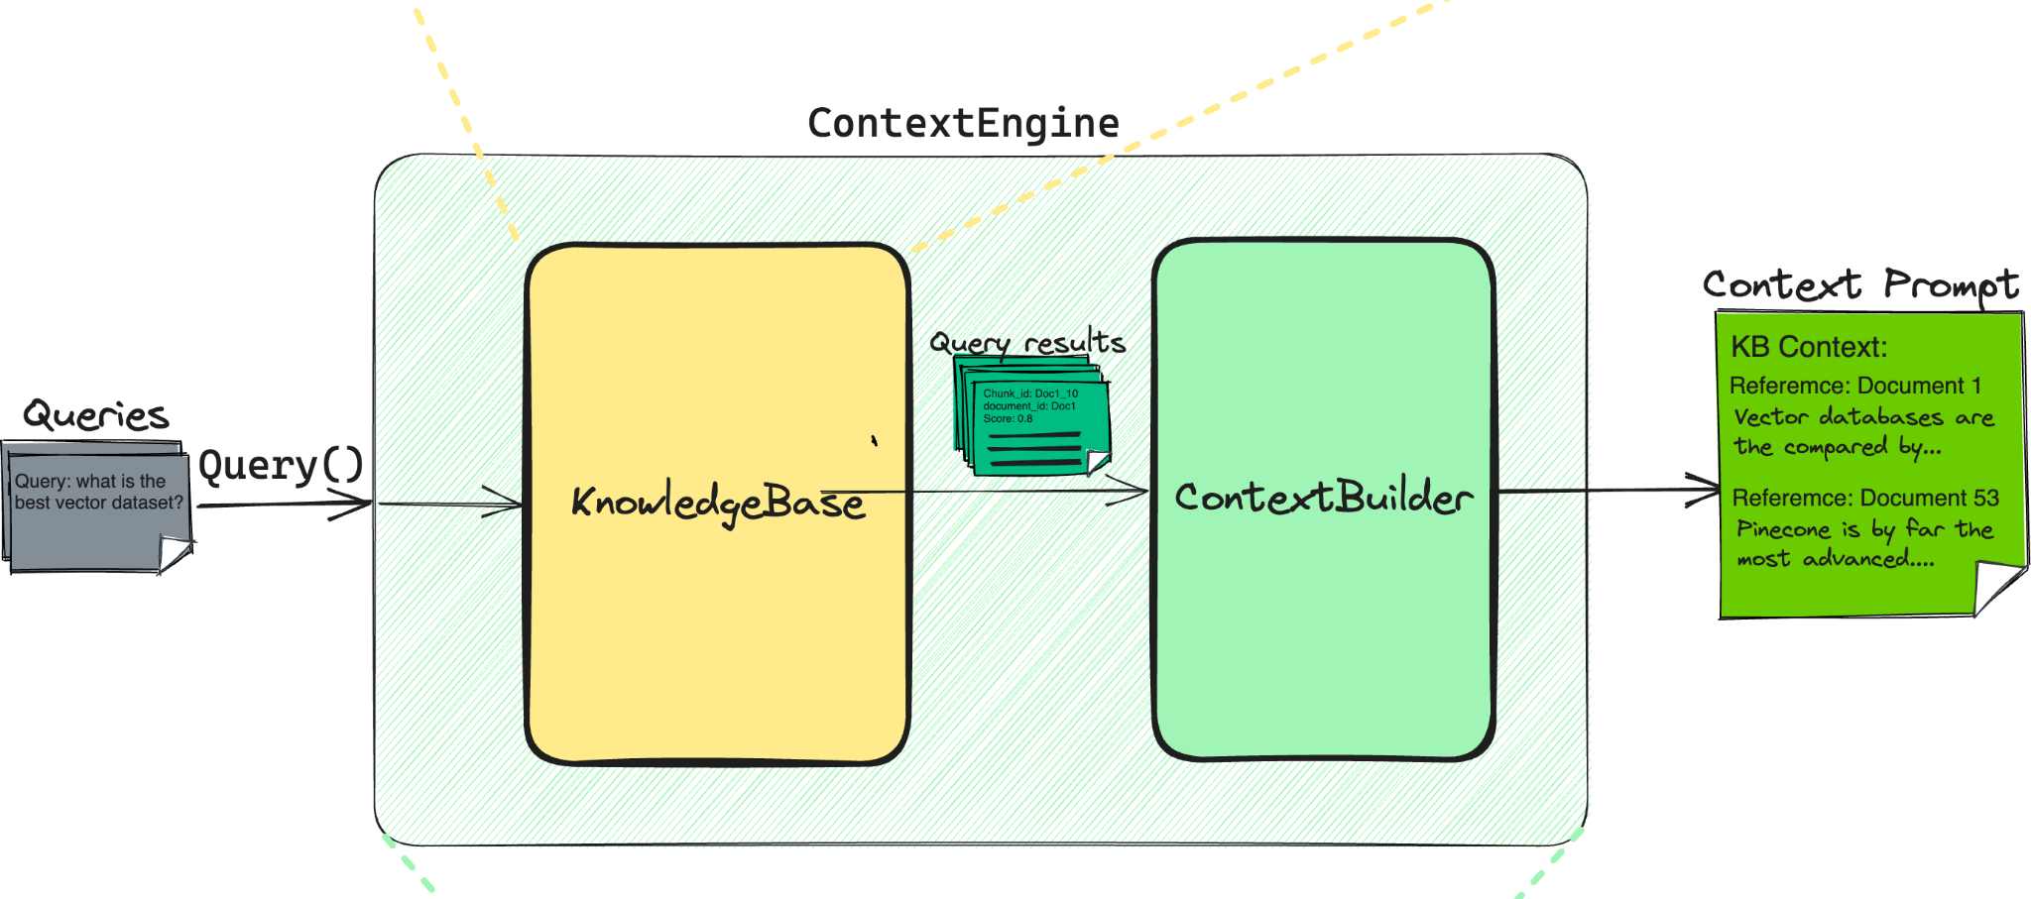
KnowledgeBase Class Workflow
https://github.com/pinecone-io/canopy/blob/main/.readme-content/class_architecture.png

Slide 15
ChatEngine Class
Exposes a chat interface
Formulates relevant queries ContextEngine using chat history
Interacts with LLM to generate responses
Notes:
ChatEngine Class
Exposes a chat interface to interact with your data.
Formulates relevant queries to the ContextEngine using history of chat messages
Interacts with the LLM to generate a knowledgeable response.

Slide 16
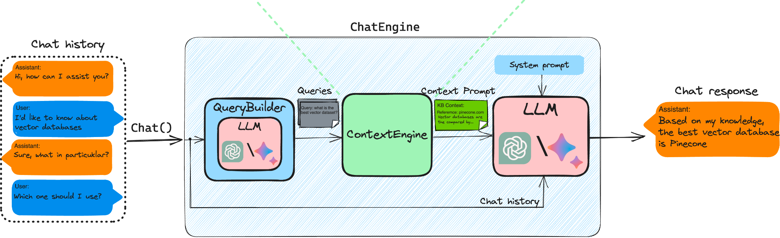
ChatEngine Class Workflow

Slide 17
Walkthrough Example
Build a RAG-LLM pipeline using Canopy:
Initialize Tokenizer
Create a knowledge base
Preparing and upserting data
Create a context engine
Create a chat engine
Testing our RAG-LLM pipeline
Working with a custom chunker (advanced)

Slide 18
Let’s set up our RAG-LLM
http://tinyurl.com/rag-canopy-colab

Slide 19
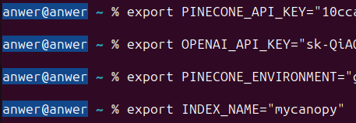
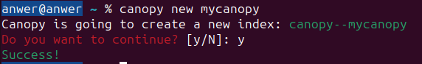
Another Alternative: Using the CLI Mode
Activate the python environment and export the Environment Variables
Create a new index

Slide 20
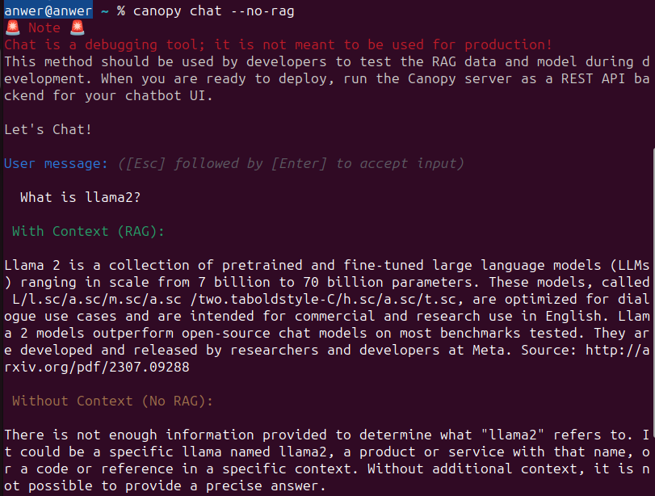
Another Alternative: Using the CLI Mode
Start a chat session

Slide 21
Another Alternative: Using the CLI Mode
Comparing RAG with NO-RAG

Slide 22
Hands on Exercise

Slide 23
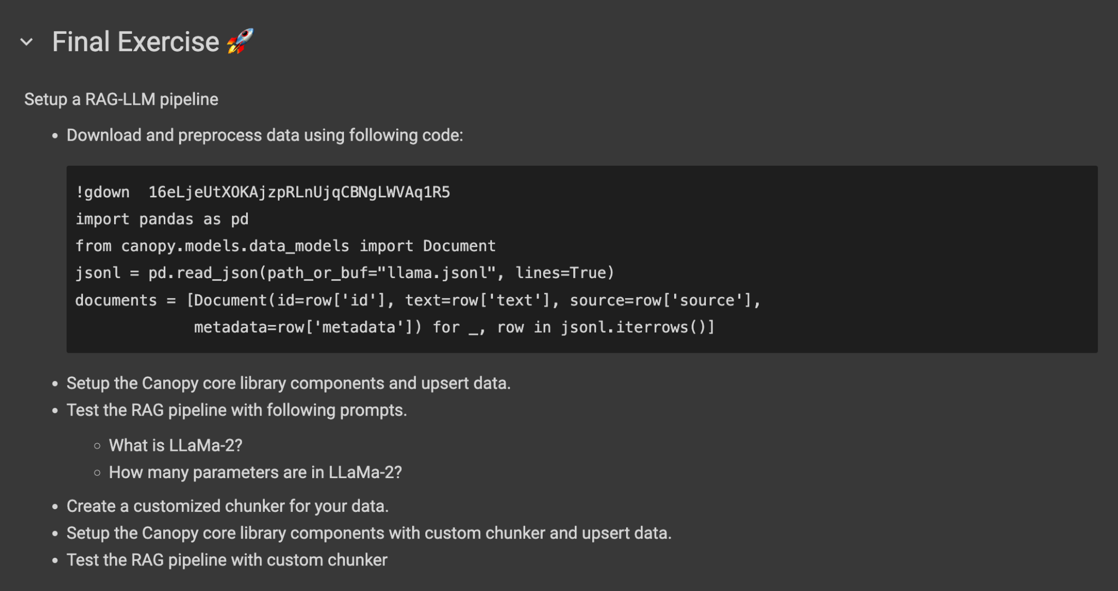

Slide 24
http://tinyurl.com/rag-canopy-colab
File > “Save a copy in Drive”
Scroll down to the last cell
Fill in your solution!

Slide 25
Final Exercise
Follow this Link for Instructions
Note: It may take multiple prompts to get things right sometimes

Slide 26
Final Quiz

Slide 27
Final Quiz - Q1
How many classes are there in the Canopy core library?
A. One (1)
B. Two (2)
C. Three (3)
D. More than three (>3)

Slide 28
Final Quiz - Q1
How many classes are there in the Canopy core library?
A. One (1)
B. Two (2)
C. Three (3)
D. More than three (>3)

Slide 29
Final Quiz - Q2
Which of the following are file formats of input data for Canopy framework? (multiple correct answers)
A. Apache Parquet
B. JSONL
C. TCT
D. PDF

Slide 30
Final Quiz - Q2
Which of the following are file formats of input data for Canopy framework? (multiple correct answers)
A. Apache Parquet
B. JSONL
C. TCT
D. PDF Coming Soon

Slide 31
Final Quiz - Q3
Which of the following is not a feature of Canopy?
A. Data Chunking
B. Data Embedding
C. Data Formatting

Slide 32
Final Quiz - Q3
Which of the following is not a feature of Canopy?
A. Data Chunking
B. Data Embedding
C. Data Formatting

Slide 33
Final Quiz - Q4
Which class handles vector database?
A. KnowledgeBase
B. ContextEngine
C. ChatEngine

Slide 34
Final Quiz - Q4
Which class handles vector database?
A. KnowledgeBase
B. ContextEngine
C. ChatEngine

Slide 35
Final Quiz - Q5
Which class interacts with the Large Language Model (LLM)?
A. KnowledgeBase
B. ContextEngine
C. ChatEngine

Slide 36
Final Quiz - Q5
Which class interacts with the Large Language Model (LLM)?
A. KnowledgeBase
B. ContextEngine
C. ChatEngine

Slide 37
Final Quiz - Q6
Which class performs the “retrieval” part of RAG?
A. KnowledgeBase
B. ContextEngine
C. ChatEngine

Slide 38
Final Quiz - Q6
Which class performs the “retrieval” part of RAG?
A. KnowledgeBase
B. ContextEngine
C. ChatEngine

Slide 39
Final Quiz - Q7
What is the flow of operations while upserting a document to index?
(choose multiple of these, in order)
A. Encode / Tokenize
B. Chunking
C. Inserting to Index
D. Search matching Query

Slide 40
Final Quiz - Q7
What is the flow of operations while upserting a document to index?
(choose multiple of these, in order)
B. Chunking
1
A. Encode / Tokenize
2
C. Inserting to Index
3
D. Search matching Query

Slide 41
Final Quiz - Q8
What are the three major components of the KnowlegeBase?

Slide 42
Final Quiz - Q8
What are the three major components of the KnowlegeBase?
Chunker

Slide 43
Final Quiz - Q8
What are the three major components of the KnowlegeBase?
Chunker
Encoder

Slide 44
Final Quiz - Q8
What are the three major components of the KnowlegeBase?
Chunker
Encoder
Pinecone Index

Slide 45
Wrap-up and Q&A
paul@zeroshotlabs.com

Slide 46
Thank You!
paul@zeroshotlabs.com

